Slide 1
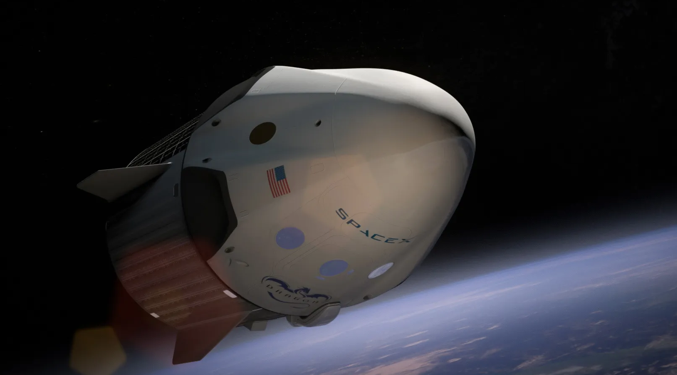

SPACE X FIRST STAGE LANDING SUCCESS PREDICTION MODEL - A ML CAPSTONE PROJECT
Albertus Erwin Susanto
2025

Slide 2

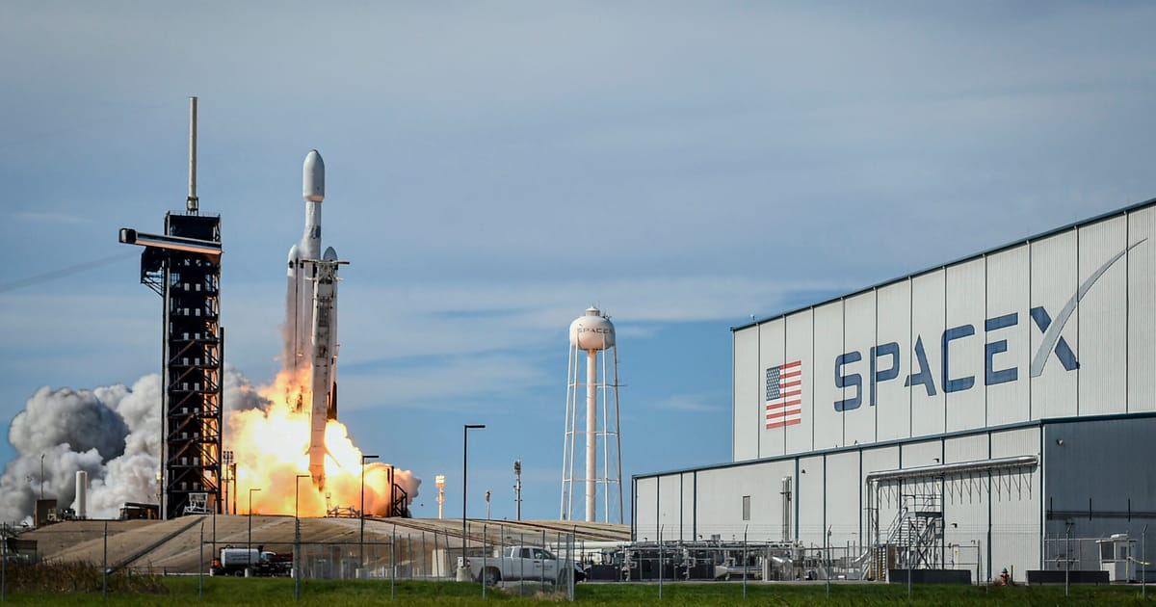
Outline
Executive Summary
Introduction
Methodology
Results
Conclusion
Appendix

Slide 3
Executive Summary
Summary of Methodologies
The research attempts to identify the factors for a successful rocket landing. Our methodologies include:
Collect data using SpaceX REST API and web scraping techniques
Wrangle data to create success/fail outcome variable
Explore data with data visualization techniques, considering the following factors: payload, launch site, flight number and yearly trend
Analyze the data with SQL, calculating the following statistics: total payload, payload range for successful launches, and total of successful and failed outcomes
Explore launch site success rates and proximity to geographical markers
Visualize the launch sites with the most success and successful payload ranges
Build Models to predict landing outcomes using logistic regression, support vector machine (SVM), decision tree and K-nearest neighbor (KNN)
Summary of Results
EDA:
Launch success has improved over time
KSC LC-39A has the highest success rate among landing sites
Orbits ES-L1, GEO, HEO, and SSO have a 100% success rate
Geographical Analysis (Folium):
Most launch sites are near the equator, and all are close to the coast.
Predictive Analysis:
All models performed similarly on the test set, i.e. accuracy of 83%.

Slide 4
Introduction
The advancements in space technology have significantly transformed the commercial space industry, with companies like SpaceX leading the way in cost-effective space exploration. One of SpaceX’s key innovations is the reusability of the Falcon 9 first-stage booster, which dramatically reduces the cost of space missions. A typical Falcon 9 launch costs $62 million, whereas other space launch providers charge over $165 million per launch. The ability to successfully land and reuse the first-stage booster is a crucial factor in these cost savings.
This capstone project focuses on predicting the successful landing of the Falcon 9 first stage. By developing a predictive model, we aim to assess the probability of a successful landing and explore its impact on launch costs. This information is particularly valuable for competing aerospace companies seeking to evaluate the feasibility of bidding against SpaceX for commercial satellite launches.

Slide 5

Section 1

Slide 6
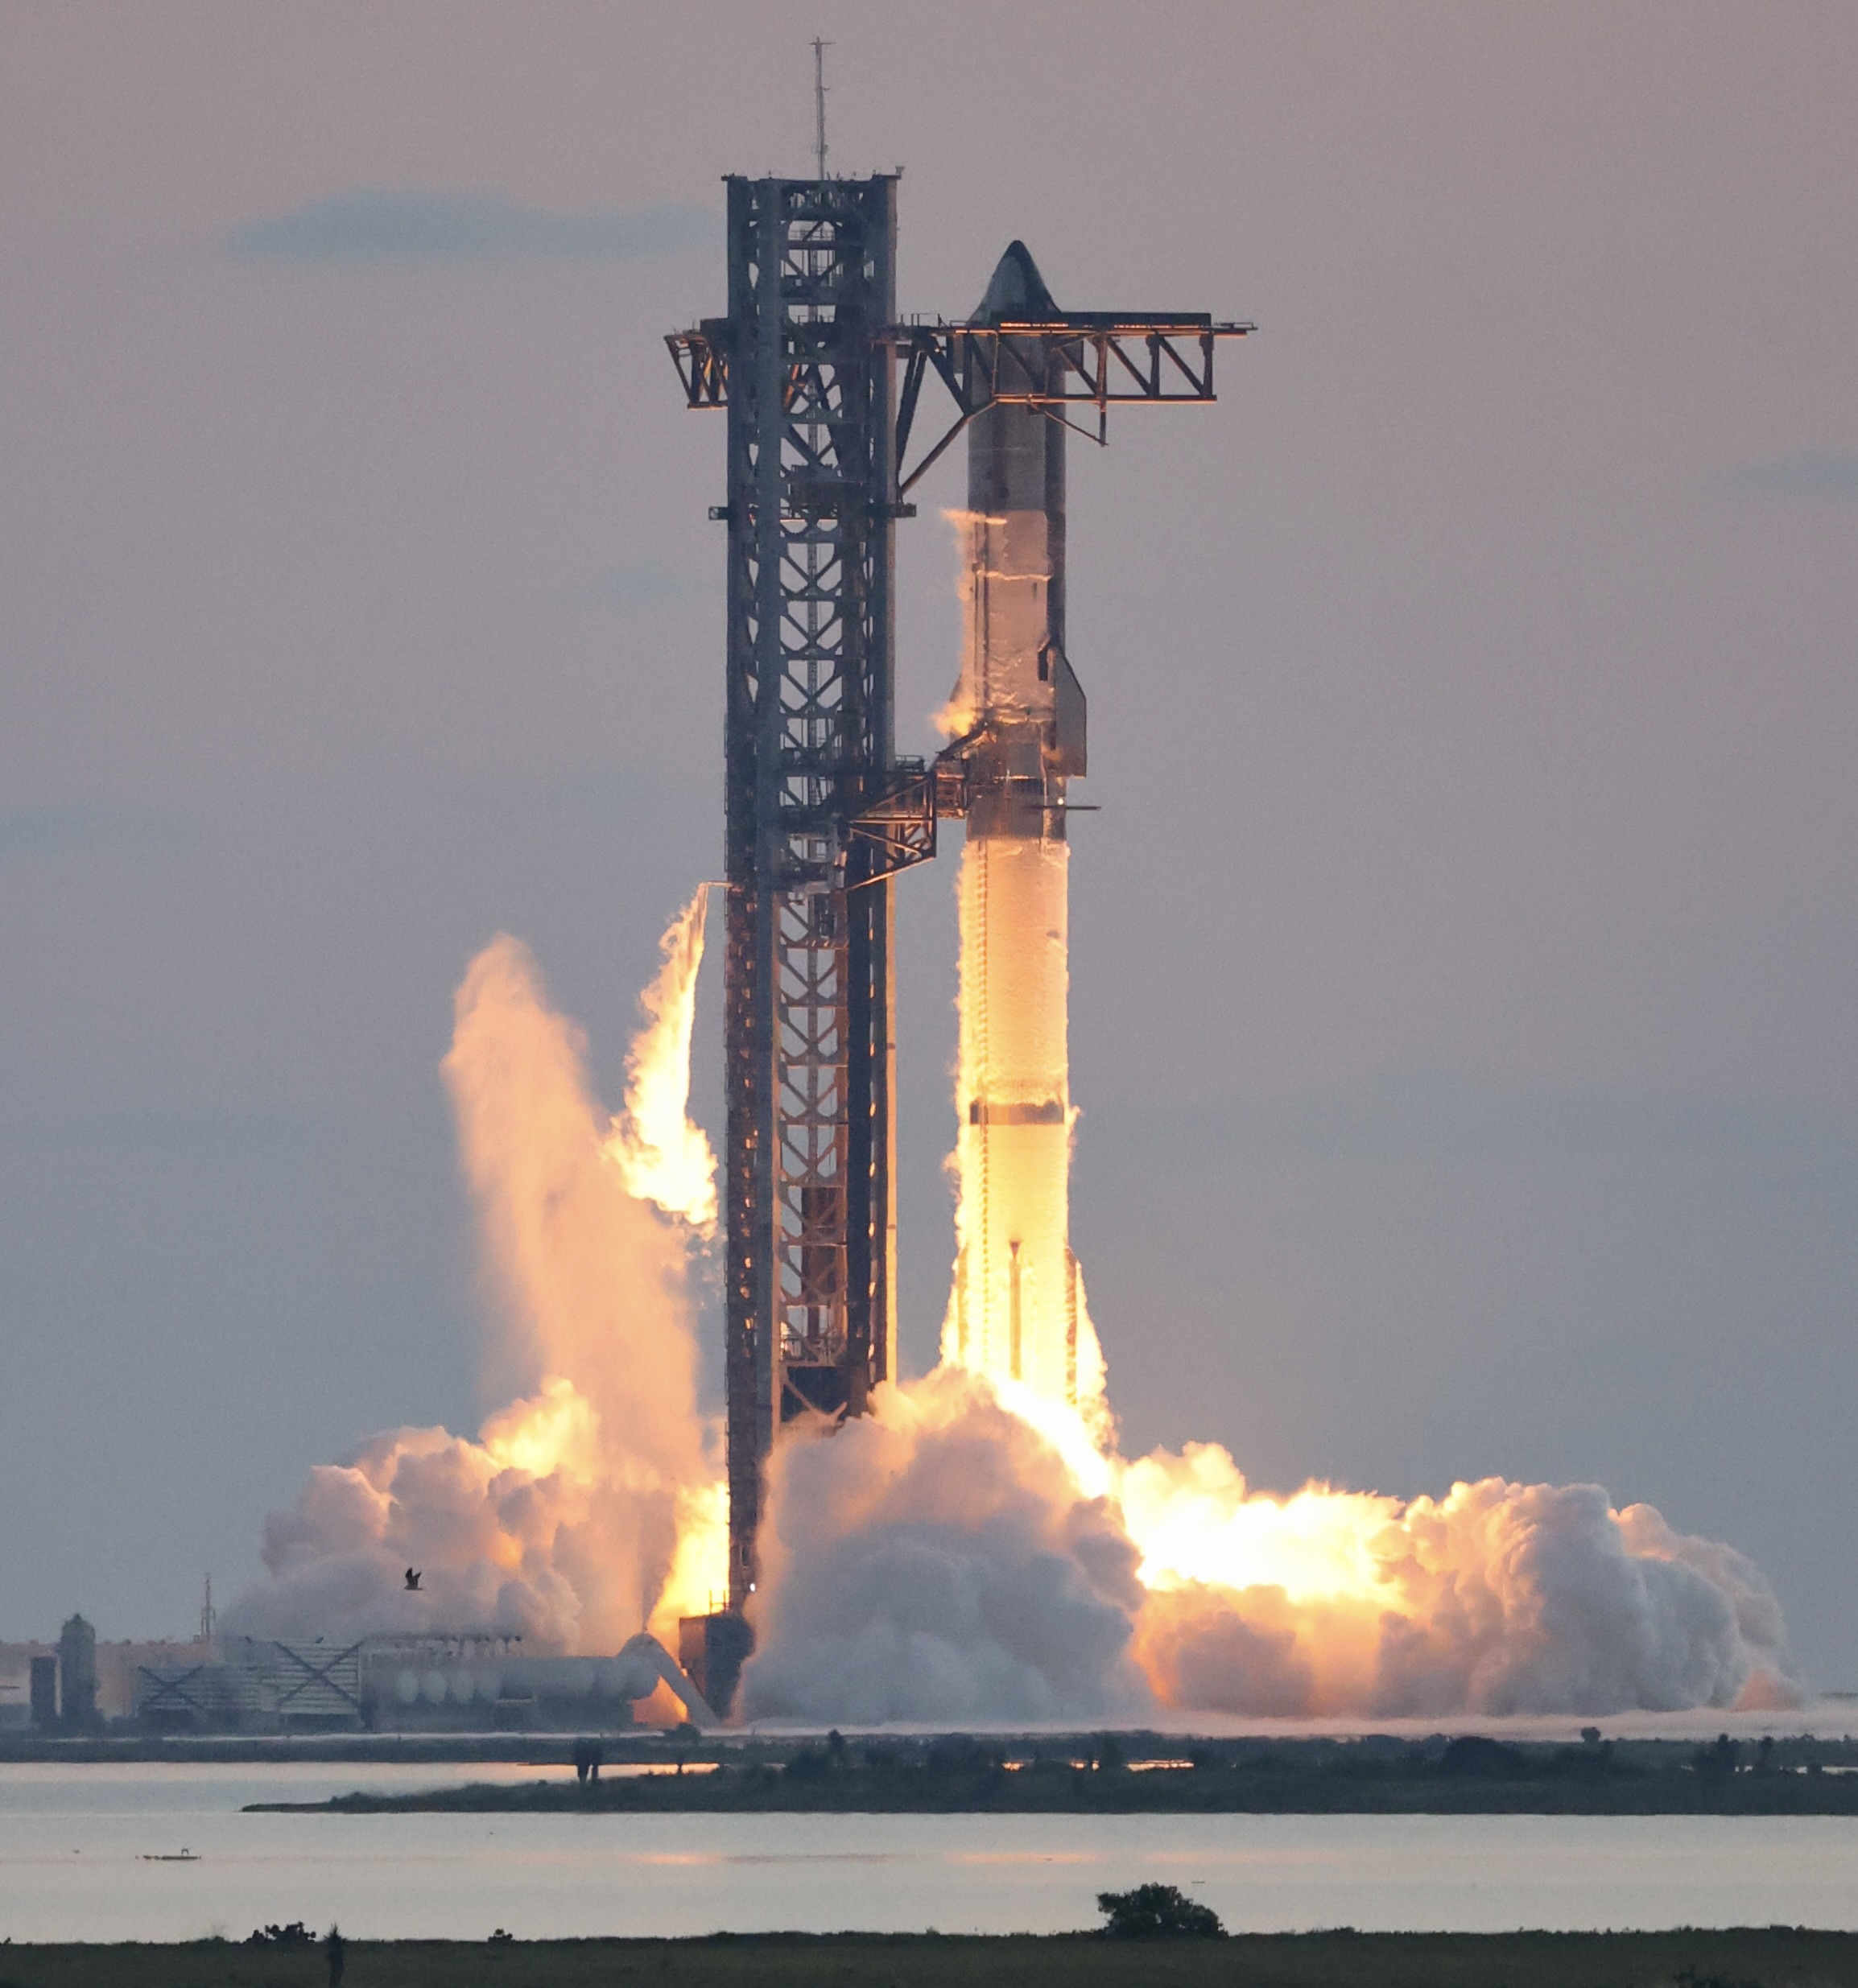
Methodology
Executive Summary
Data collection methodology: through SpaceX API and web scrapping Wikipedia.
Perform data wrangling
Perform exploratory data analysis (EDA) using visualization and SQL
Perform interactive visual analytics using Folium and Plotly Dash
Perform predictive analysis using classification models: Logistic Regression, SVM, KNN, and Decision Tree.

Slide 7
Data Collection – by SpaceX API
To build a predictive model for Falcon 9 first-stage landings, we needed historical launch data from SpaceX. This data was collected using the SpaceX API, which provides structured information on past launches, including launch details, payload specifications, booster versions, and landing outcomes. The following steps summarize the data retrieval process:
API Retrieval: Extracted past launch records from https://api.spacexdata.com/v4/launches/past, including rocket type, launch site, payload mass, orbit, and landing success.
Feature Extraction: Queried additional API endpoints to map rocket IDs to booster versions, retrieve launchpad locations, and fetch payload and core details.
Data Cleaning & Transformation: Processed missing values, converted categorical variables, and structured the dataset for analysis.
Storage: The final dataset was saved as a CSV file for machine learning modeling.

Slide 8
Data Collection – by SpaceX API
After wrangling the data we get from the API, we collect the features, including FlightNumber, Date, BoosterVersion, PayloadMass, Orbit, LaunchSite, Outcome, Flights, GridFins, Reused, Legs, LandingPad, Block, ReusedCount, Serial, Longitude, Latitude.
See the result at: https://github.com/aerwins-yyw/space_x-first_stage_landing/blob/332b637cfa0987aa7842a93306204b0fe8fbbfa8/1%20jupyter-labs-spacex-data-collection-api-v2.ipynb

Slide 9
Data Collection – by Web Scrapping
We also try to collect the data through an alternative way as part of learning in this project, that is through web scrapping.
We perform web scraping to collect Falcon 9 historical launch records from a Wikipedia page titled `List of Falcon 9 and Falcon Heavy launches`.
The link: https://en.wikipedia.org/wiki/List_of_Falcon_9_and_Falcon_Heavy_launches
For the sake of uniformity, the link we used is the static version: https://en.wikipedia.org/w/index.php?title=List_of_Falcon_9_and_Falcon_Heavy_launches&oldid=1027686922
See the result at: https://github.com/aerwins-yyw/space_x-first_stage_landing/blob/332b637cfa0987aa7842a93306204b0fe8fbbfa8/2%20jupyter-labs-webscraping.ipynb

Slide 10
Data Wrangling
During the data wrangling phase, I cleaned and prepared the dataset for further analysis. Here’s what I did step by step:
Checked for Missing Values and Data Types: To ensure data integrity, I checked for missing values. I also examined the data types to identify any necessary conversions.
Explored Key Features: To understand the dataset better, I used to analyze (1) Launch sites to determine which locations had the most launches and (2) Orbit types to identify common orbital destinations.
Processed Landing Outcomes: Since the dataset contained different landing outcomes, I examined the Outcome column using df["Outcome"].value_counts(). I then categorized the outcomes into two groups (1) Successful landings (reusable boosters) and (2) Unsuccessful landings (e.g., ocean landings, crashes). To label these outcomes, I created a binary classification variable (Class): 1 for successful landings, 0 for failed landings.
Calculated Landing Success Rate: To measure overall landing performance, I calculated the success rate using df["Class"].mean() and printed the result.
Saved the Processed Dataset: Finally, I saved the cleaned dataset as dataset_part_2.csv, ensuring it was structured and ready for analysis.
See the result at: https://github.com/aerwins-yyw/space_x-first_stage_landing/blob/332b637cfa0987aa7842a93306204b0fe8fbbfa8/3%20labs-jupyter-spacex-Data%20wrangling-v2.ipynb

Slide 11
EDA with SQL
To get the preliminary insights from our data, we make an exploratory data analysis using SQL queries. Here are what I did:
Creating a Cleaned Table (SPACEXTABLE): I started by creating a new table called SPACEXTABLE based on SPACEXTBL, but I made sure to exclude rows where the Date column was null. This helped me clean the dataset and ensure that all records in my new table contained valid dates.
Exploring the Data: After creating SPACEXTABLE, I ran a simple SELECT * query to view all the records. This allowed me to verify that the data was correctly transferred and filtered.
Finding Unique Launch Sites: I wanted to see all the different launch sites used in the dataset, so I used SELECT DISTINCT LAUNCH_SITE to retrieve a list of unique launch sites. This gave me a clearer idea of the different locations from which SpaceX launches its rockets.

Slide 12
EDA with SQL
Filtering Data for a Specific Launch Site (CCAFS LC-40): To focus on launches from the CCAFS LC-40 site, I wrote a query to filter records where LAUNCH_SITE matched 'CCAFS LC-40' and limited the results to 5 rows. This helped me examine the data specific to that launch site without pulling an overwhelming number of records.
Calculating Total Payload Mass for NASA CRS Missions: Lastly, I wanted to analyze the total payload mass for NASA's Commercial Resupply Services (CRS) missions. I used SUM(PAYLOAD_MASS__KG_) while filtering for records where the CUSTOMER column contained 'NASA (CRS)'. This helped me understand the total weight of payloads that SpaceX launched for NASA's CRS program.
To see the complete code and the result, see here: https://github.com/aerwins-yyw/space_x-first_stage_landing/blob/332b637cfa0987aa7842a93306204b0fe8fbbfa8/5%20jupyter-labs-eda-dataviz-v2.ipynb

Slide 13
EDA with Panda and Matplotlib
Using the data collected, I continue the exploratory data analysis by making plots to see the relationship between features. The plots I made include:
Scatter plot on the relationship between Flight Number and Launch Site
Scatter plot on the relationship between launch sites and their payload mass
Horizontal bar chart on the relationship between success rate of each orbit type
Scatter plot on the relationship between Flight Number and Orbit type
Scatter plot on the relationship between Payload and Orbit type
Line chart to see the average launch success trend
The features we have include: 'FlightNumber', 'PayloadMass', 'Orbit', 'LaunchSite', 'Flights', 'GridFins', 'Reused', 'Legs', 'LandingPad', 'Block', 'ReusedCount', 'Serial’
After observing those relationship, we apply OneHotEncoder to the column Orbits, LaunchSite, LandingPad, and Serial.
To see more details, please check on: https://github.com/aerwins-yyw/space_x-first_stage_landing/blob/2ea031da325b1cc0d1fd776762897ff5cc764e66/5%20jupyter-labs-eda-dataviz-v2.ipynb

Slide 14
Build an Interactive Map with Folium
Here, I conduct an analysis on the geographical location of the launch sites. The steps include:
Downloading and Loading the Dataset: I downloaded the spacex_launch_geo.csv file and loaded it into a pandas DataFrame. This dataset contains information about SpaceX launch sites, including their latitude, longitude, and success classification.
Selecting Relevant Columns and Organizing Data: I filtered the dataset to keep only the essential columns:
Launch Site: The name of the launch site
Lat (Latitude): The geographic latitude of the launch site
Long (Longitude): The geographic longitude of the launch site
class: The success classification of the launch

Slide 15
Build an Interactive Map with Folium
Grouping: I then grouped the data by launch site to get unique site locations.
Creating a Base Map: I initialized a folium map centered around NASA Johnson Space Center, setting an appropriate zoom level to visualize the launch sites.
Next Steps: Based on this setup, I went on to:
Add markers for different launch sites on the map.
Cluster them using MarkerCluster for better visualization.
Display additional information such as launch success rates or coordinates when hovering over a site.
For further details, please check: https://github.com/aerwins-yyw/space_x-first_stage_landing/blob/2271789ba5068fbad731edaa2a6b8bd8d05ad48b/6%20lab-jupyter-launch-site-location-v2.ipynb

Slide 16
Build a Dashboard with Plotly Dash
Then I built a dashboard with Plotly Dash. I decided to run it locally instead of from the Skills Learn platform provided by IBM to have more control on the dashboard. The steps include:
I began by importing key libraries for building the dashboard:
dash, dash_html_components, and dash_core_components to create the web-based dashboard.
plotly.express for interactive visualizations.
pandas for data handling.
wget to download the dataset.
Downloading and Loading SpaceX Launch Data: I downloaded the spacex_launch_dash.csv file and loaded it into a pandas DataFrame. This dataset contains information about SpaceX launches, including: Launch site, Payload mass, Class (successful or failed launches), Booster versions.
Examining the First Few Rows: I checked the first 10 rows of the dataset using .head(10) to get an overview of the data structure.

Slide 17
Build a Dashboard with Plotly Dash
Downloading a Dash App Skeleton: I downloaded a template (spacex_dash_app.py), which likely provided a starting point for building the dashboard.
Identifying Min and Max Payload Mass: I extracted the minimum and maximum payload mass from the dataset, which would be useful for setting range selectors in the dashboard.
Creating a Dash Application: I initialized a Dash app, which serves as the foundation for building an interactive web application.
For further details, please check: https://github.com/aerwins-yyw/space_x-first_stage_landing/blob/2271789ba5068fbad731edaa2a6b8bd8d05ad48b/7%20lab-jupyter-dash.ipynb

Slide 18
Predictive Analysis (Classification)
Here we conduct our predictive analysis by building our classification models. The steps include:
Importing Libraries for Data Processing and Machine Learning: I started by importing essential libraries:
pandas and numpy for handling and manipulating data
matplotlib.pyplot and seaborn for visualizations.
sklearn.preprocessing for standardizing features.
sklearn.model_selection for splitting data and performing hyperparameter tuning.
Defining a Function to Plot the Confusion Matrix: I wrote a function, plot_confusion_matrix(), to visualize the model's performance. It computes the confusion matrix using sklearn.metrics.confusion_matrix(). Uses seaborn's heatmap to display classification accuracy. Labels axes to distinguish between successful and unsuccessful landings.
Loading SpaceX Launch Data: I loaded dataset_part_2.csv, which contains relevant data on Falcon 9 launches. Then I extracted the target variable (Class), which indicates whether the first stage successfully landed (1) or failed (0). Then, I loaded dataset_part_3.csv, which contains the feature set (X) for training my models.

Slide 19
Predictive Analysis (Classification)
Preprocessing the Data: I standardized the feature set using StandardScaler() from sklearn.preprocessing to ensure that all numerical variables are on the same scale. I split the dataset into training (80%) and testing (20%) subsets using train_test_split(). This helped in evaluating model performance effectively.
Training Machine Learning Models: I trained four classification models to predict whether a Falcon 9 first stage would successfully land:
Logistic Regression: A simple linear classifier useful for binary outcomes.
Support Vector Machines (SVM): Helps separate classes with an optimal hyperplane.
Decision Tree: A model that learns from data by splitting features based on decision rules.
K-Nearest Neighbors (KNN): Classifies data based on the majority of neighboring points.
Evaluating Model Performance: I compared the models based on accuracy and confusion matrices. I used GridSearchCV() for hyperparameter tuning, ensuring each model had the best-performing settings.
For further details please check: https://github.com/aerwins-yyw/space_x-first_stage_landing/blob/08d5e579ea713dd3b1623eaa68dc70ceb84b88ca/8%20SpaceX-Machine-Learning-Prediction-Part-5-v1.ipynb

Slide 20

Section 2

Slide 21
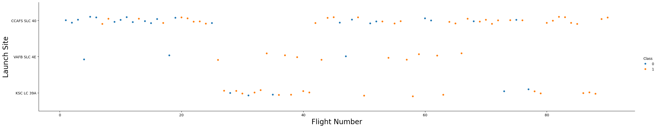
Flight Number vs. Launch Site
Earlier flights had a lower success rate (blue = fail)
• Later flights had a higher success rate (orange = success)
• Around half of launches were from CCAFS SLC 40 launch site
• VAFB SLC 4E and KSC LC 39A have higher success rates
• We can infer that new launches have a higher success rate

Slide 22
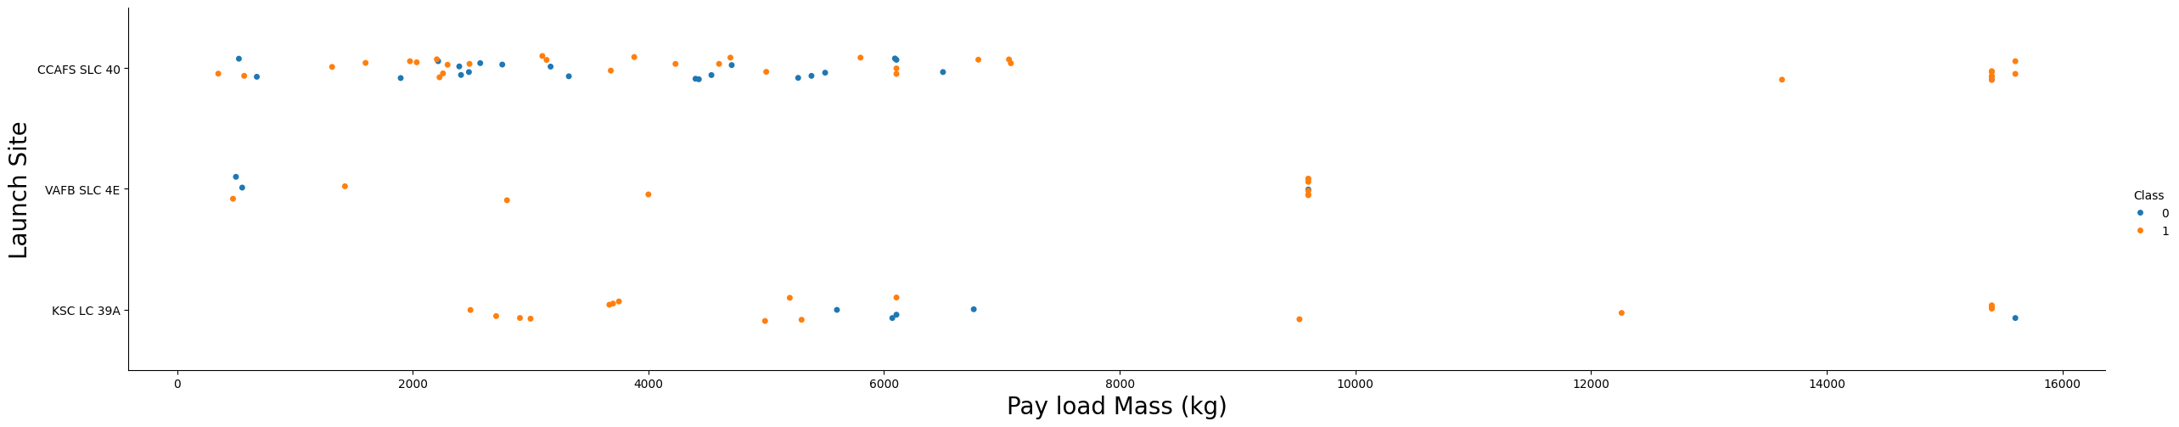
Payload vs. Launch Site
• Typically, the higher the payload mass (kg), the higher the success rate
• Most launces with a payload greater than 7,000 kg were successful
• KSC LC 39A has a 100% success rate for launches less than 5,500 kg
• VAFB SKC 4E has not launched anything greater than ~10,000 kg

Slide 23
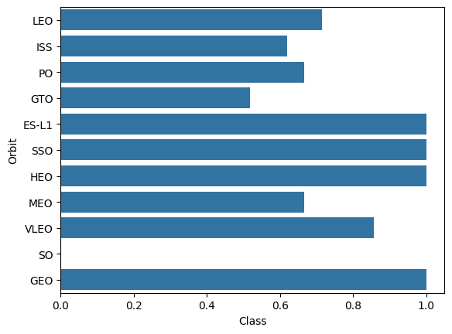
Success Rate vs. Orbit Type
100% Success Rate: ES-L1, GEO, HEO and SSO
50%-80% Success Rate: GTO, ISS, LEO, MEO, PO
0% Success Rate: SO

Slide 24
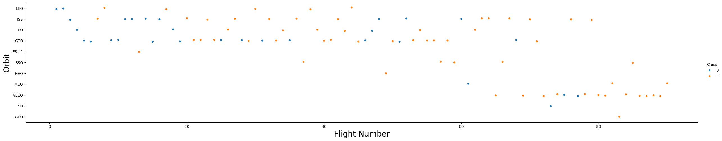
Flight Number vs. Orbit Type
The success rate typically increases with the number of flights for each orbit
This relationship is highly apparent for the LEO orbit
The GTO orbit, however, does not follow this trend

Slide 25
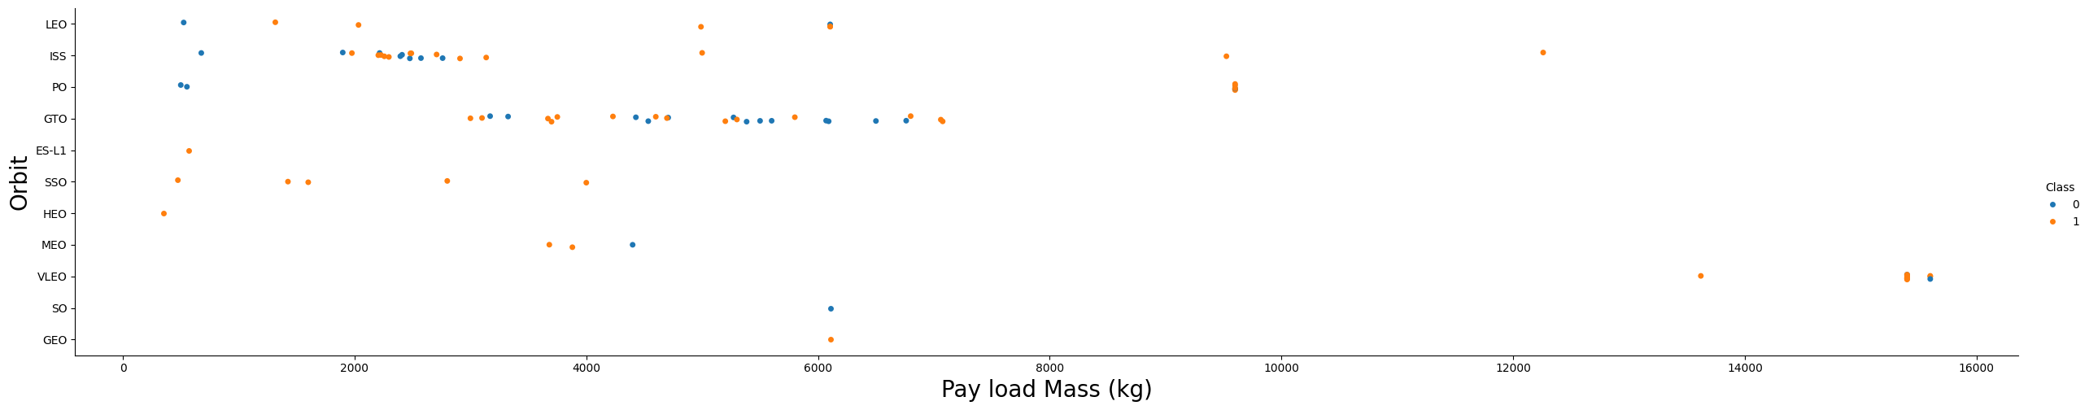
Payload vs. Orbit Type
Heavy payloads are better with LEO, ISS and PO orbits
The GTO orbit has mixed success with heavier payloads

Slide 26
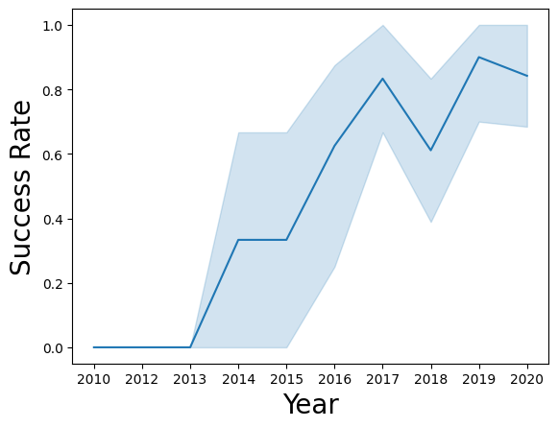
Launch Success Yearly Trend
The success rate improved from 2013-2017 and 2018-2019
The success rate decreased from 2017-2018 and from 2019-2020
Overall, the success rate has improved since 2013

Slide 27
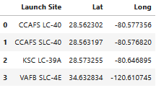
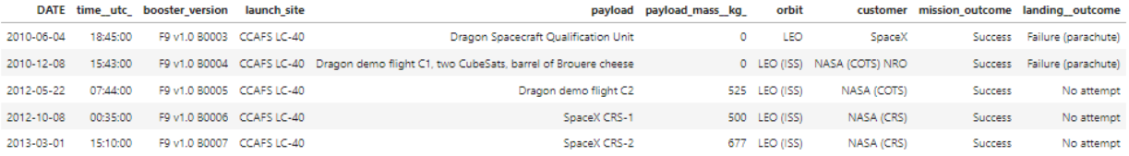
Launch Site
The launch sites are: CCAFS LC-40, CCAFS SLC-40, KSC LC-39A, VAFB SLC-4E.
The table below shows the 5 records from the launch site CCAFS LC-40.

Slide 28
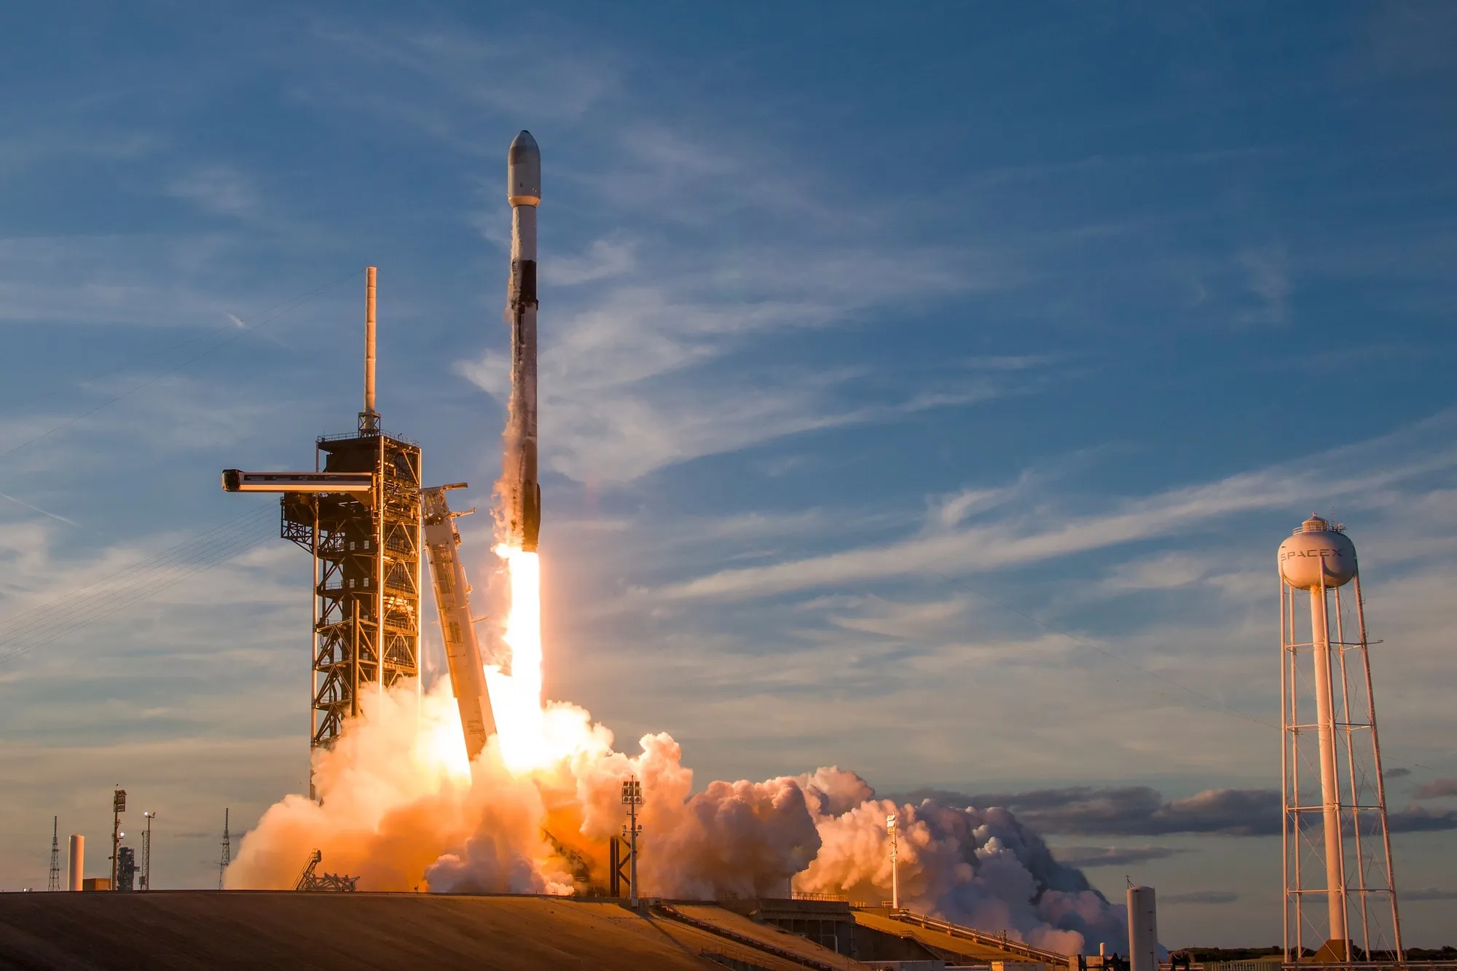
Payload Mass
45,596 kg (total) carried by boosters launched by NASA (CRS)
2,928 kg (average) carried by booster version F9 v1.1

Slide 29
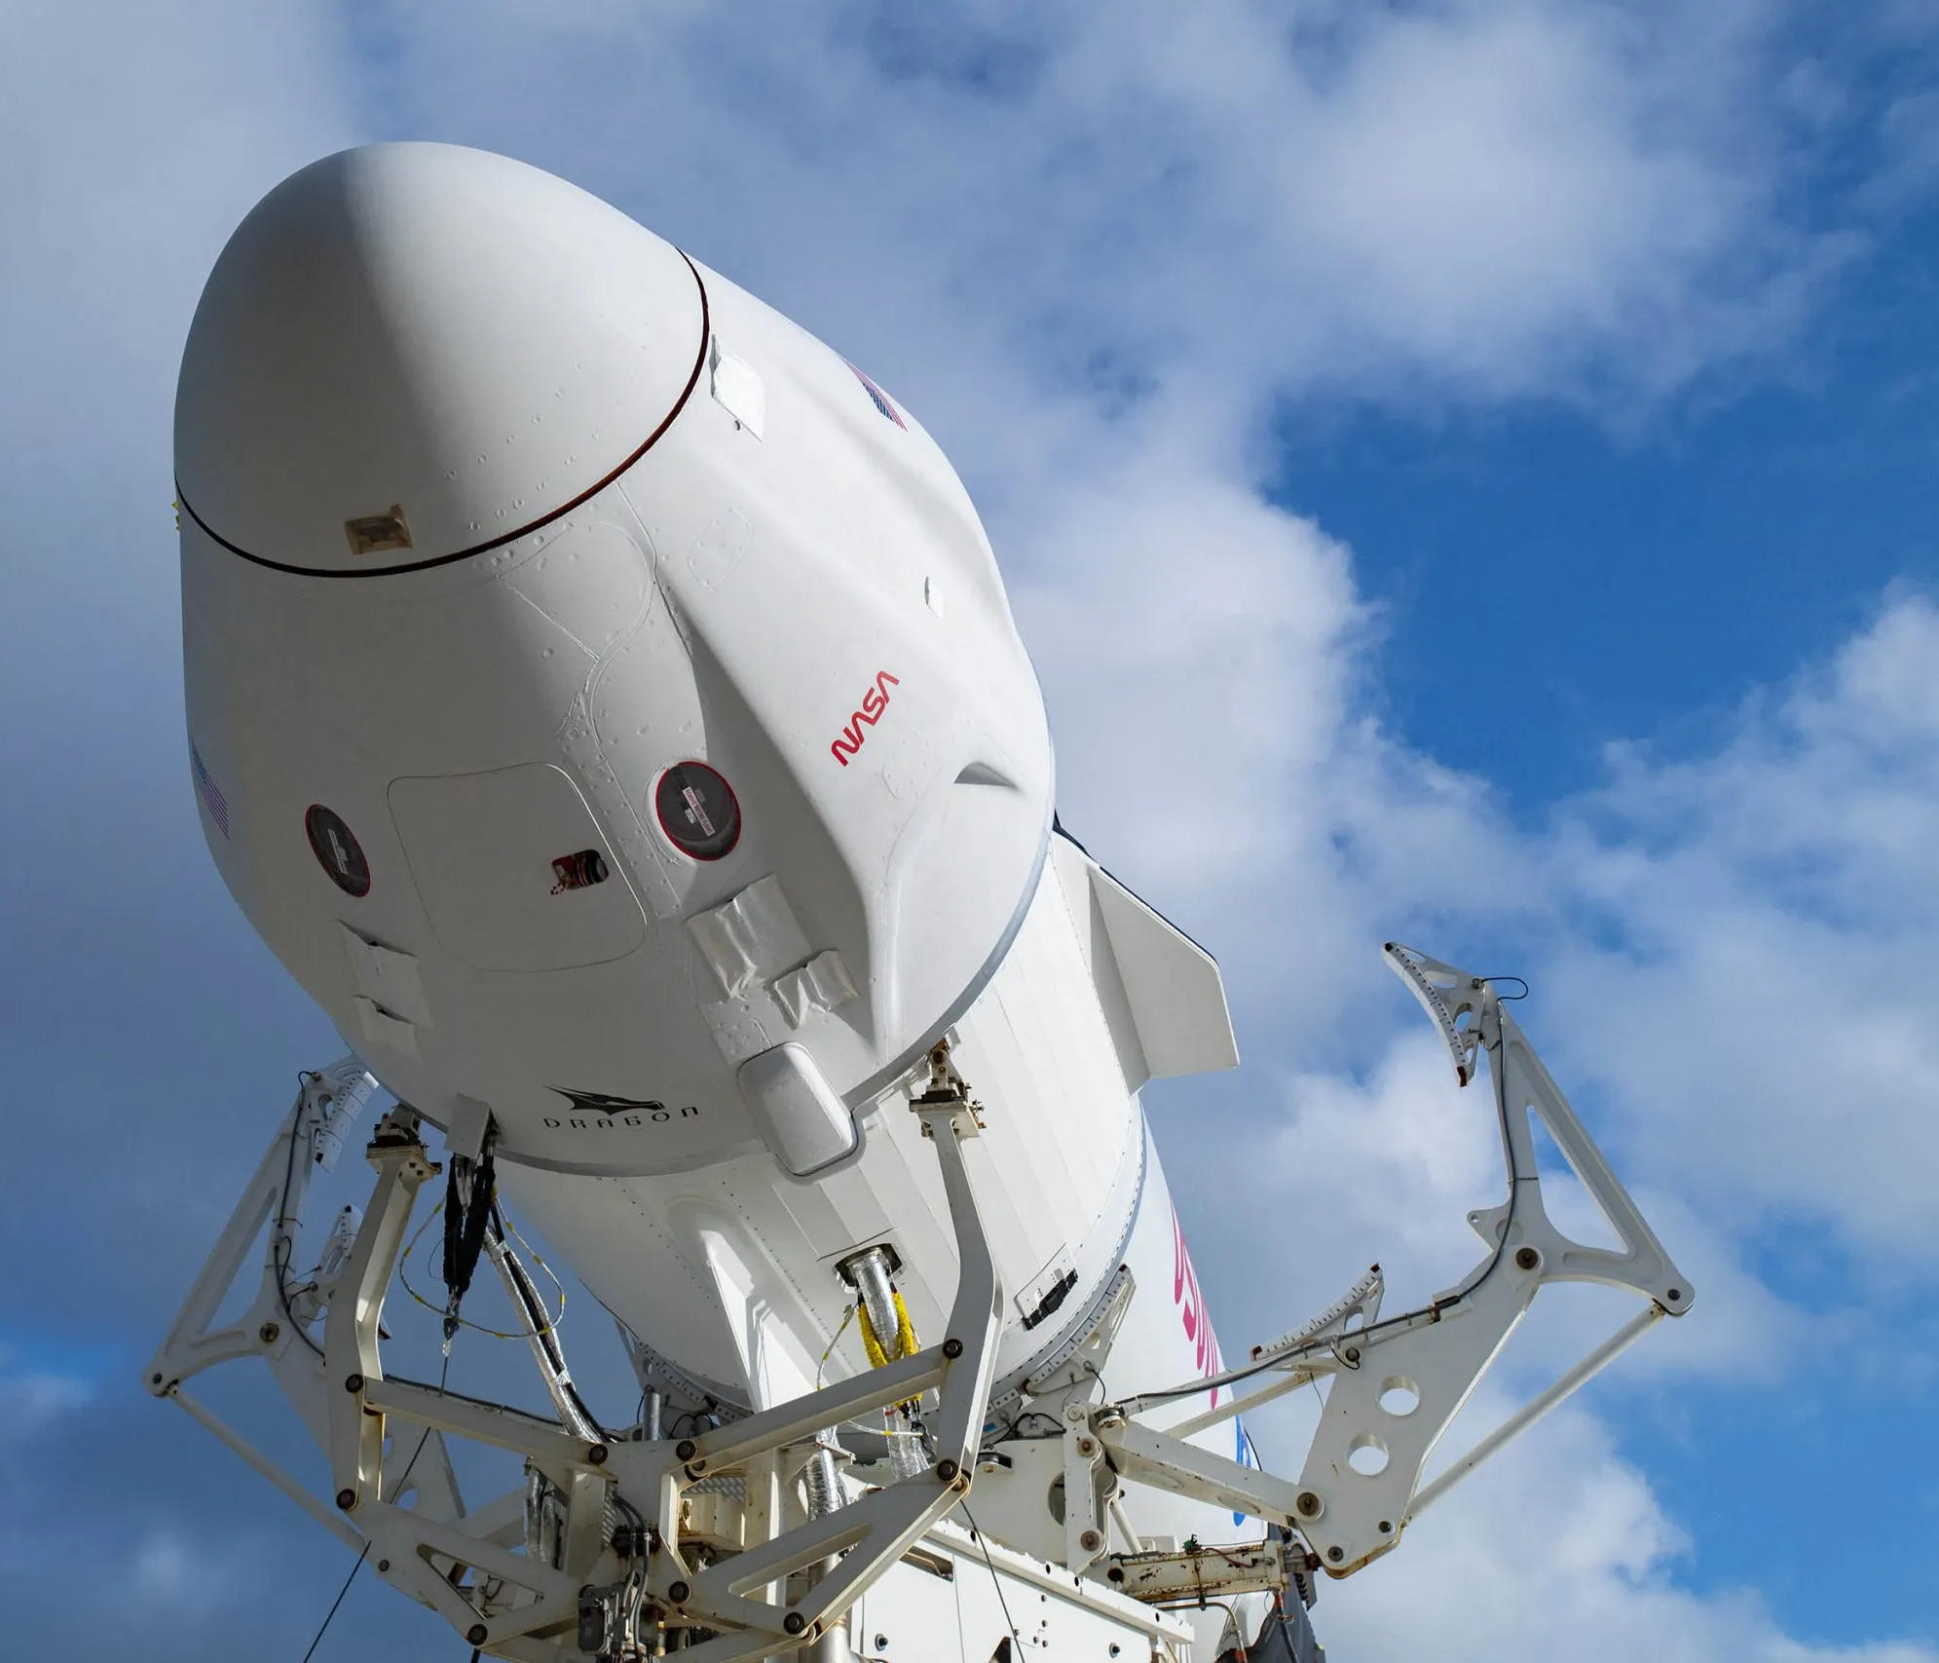
Landing Mission Info
1st Successful Landing in Ground Pad is on 12/22/2015
Booster mass greater than 4,000 but less than 6,000: JSCAT-14, JSCAT-16, SES-10, SES-11 / EchoStar 105
Total Number of Successful and Failed Mission Outcomes:
1 Failure in Flight
99 Success
1 Success (payload status unclear)

Slide 30
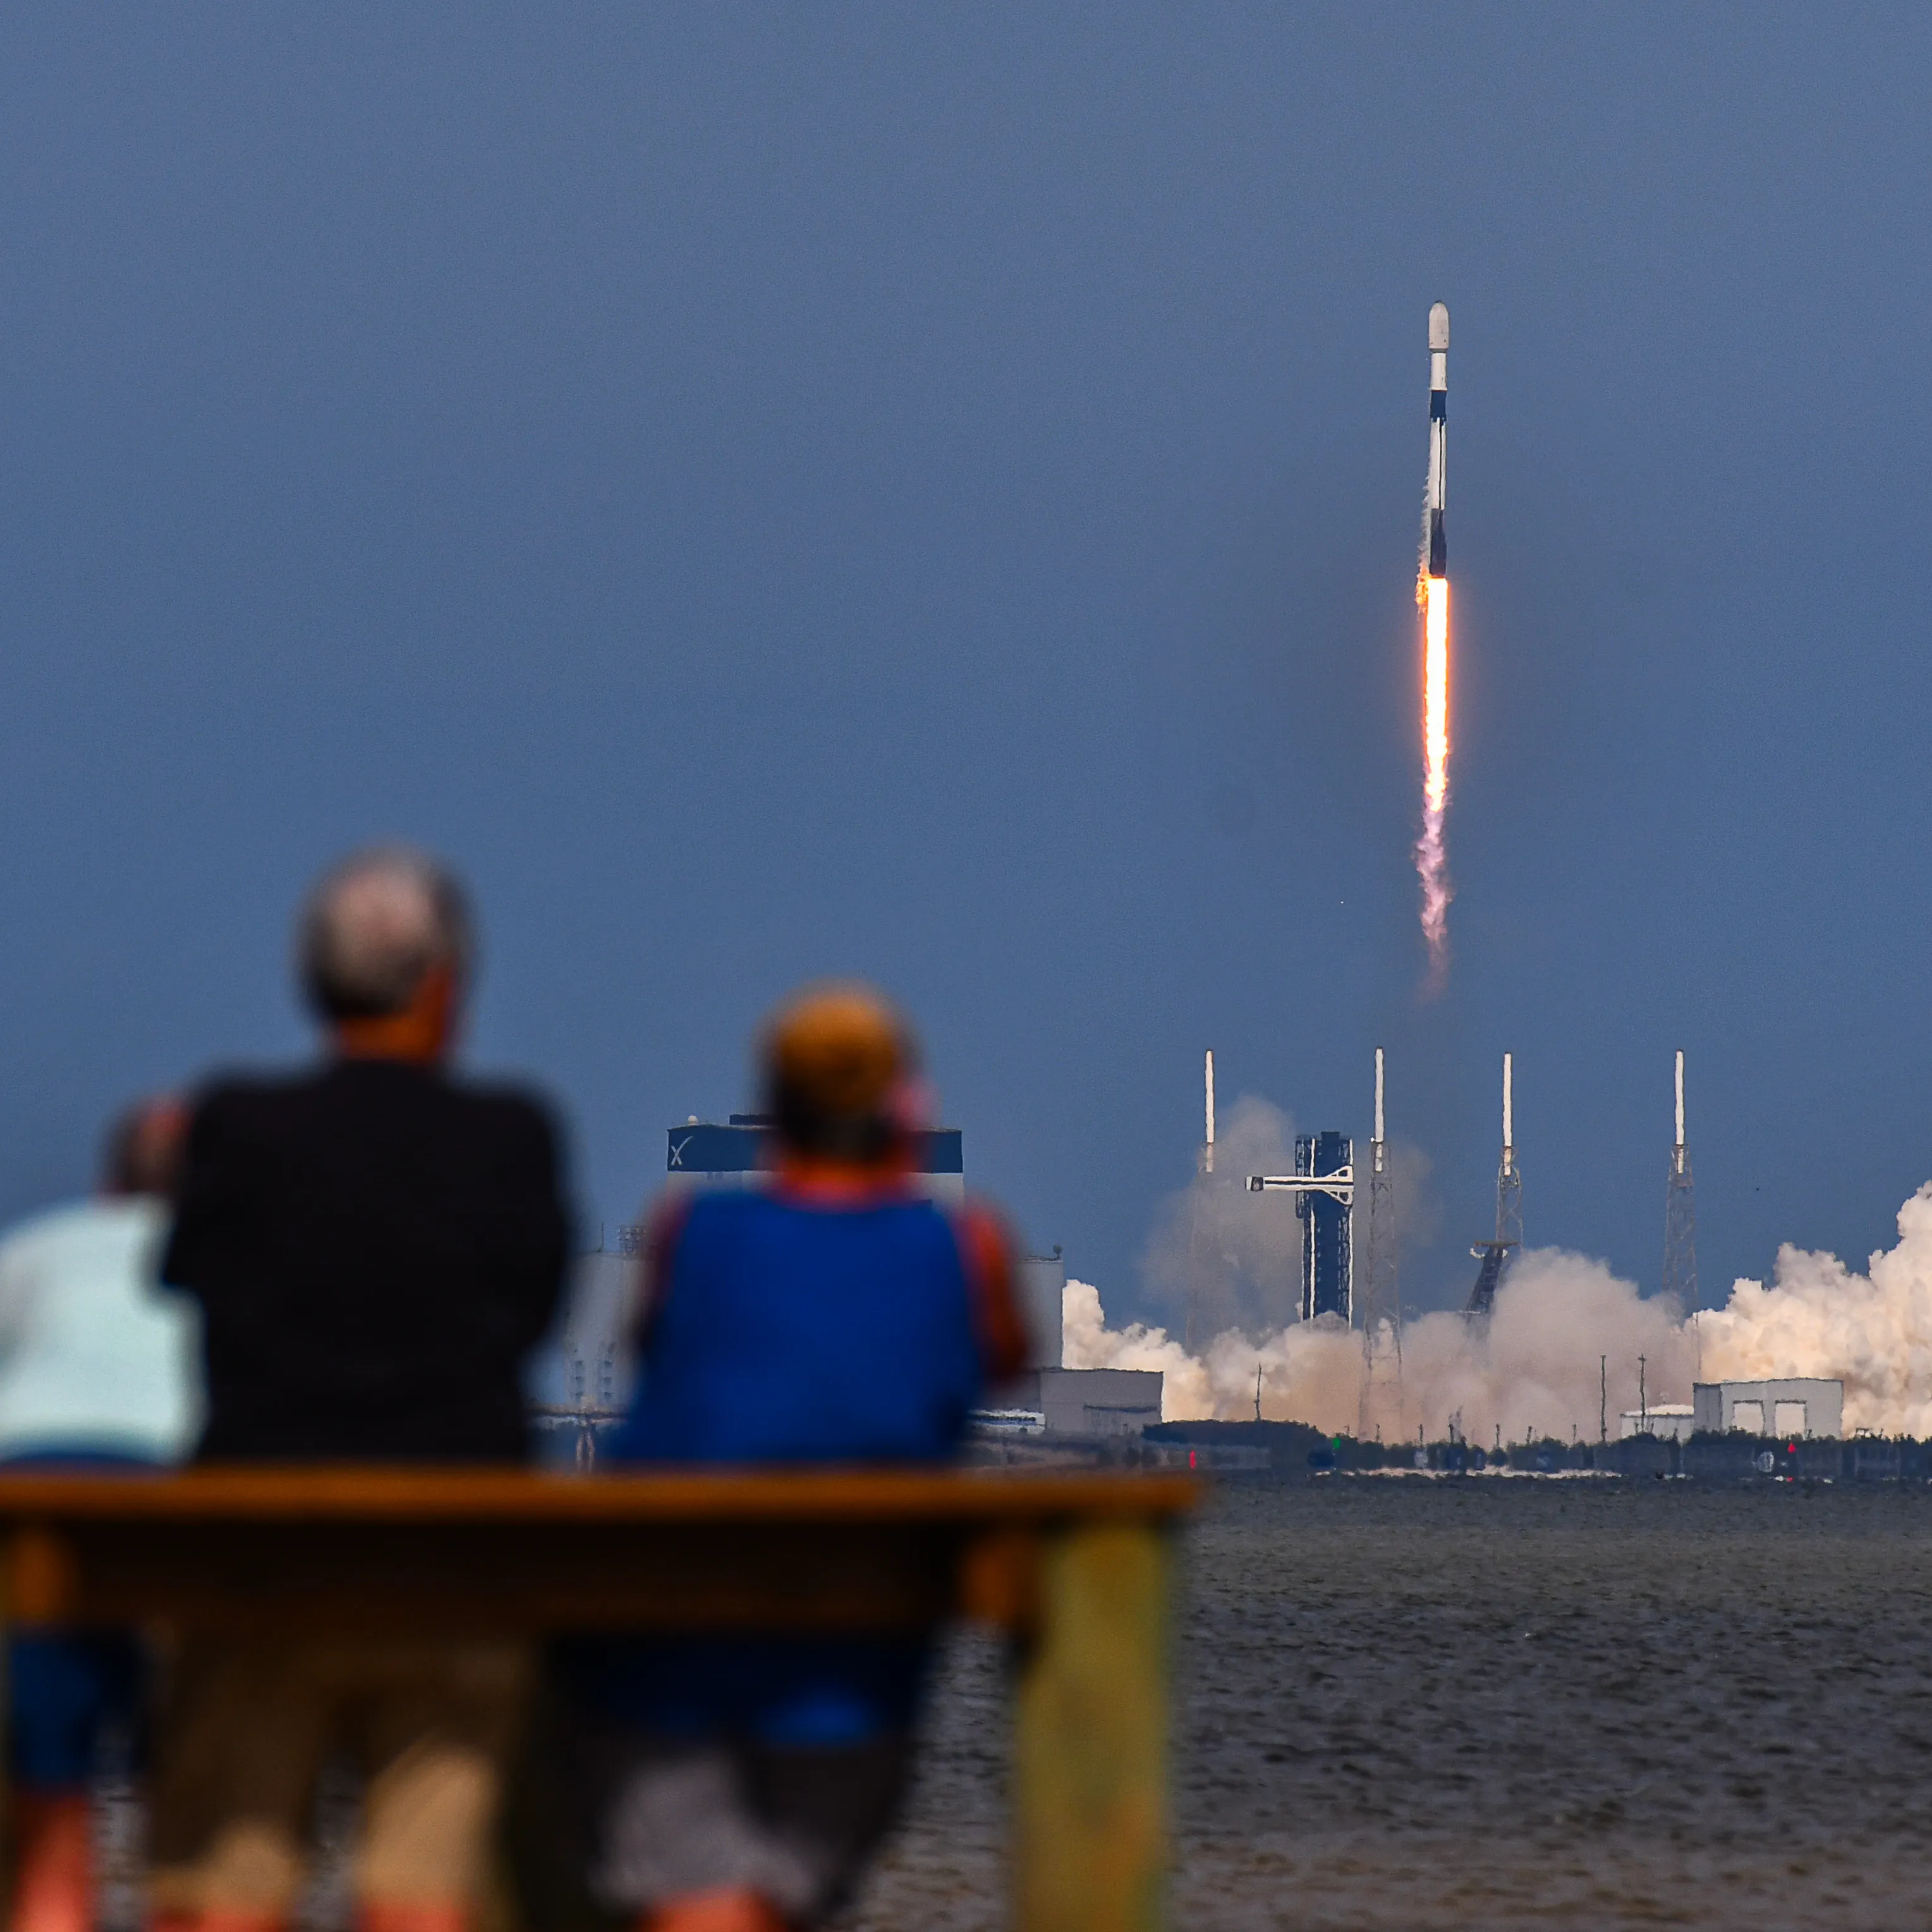
Boosters Carried Max Payload
Boosters that Carried Max Payload:
F9 B5 B1048.4
F9 B5 B1049.4
F9 B5 B1051.3
F9 B5 B1056.4
F9 B5 B1048.5
F9 B5 B1051.4
F9 B5 B1049.5
F9 B5 B1060.2
F9 B5 B1058.3
F9 B5 B1051.6
F9 B5 B1060.3
F9 B5 B1049.7

Slide 31
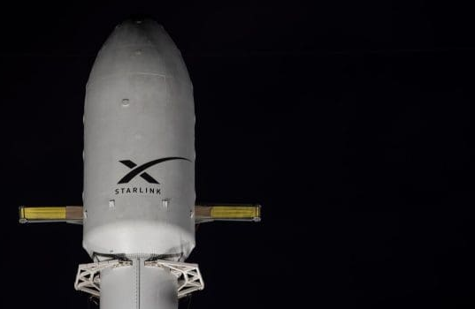
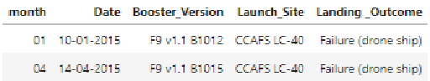
2015 Launch Records
The failed landing_outcomes in drone ship, their booster versions, and launch site names for in year 2015:

Slide 32
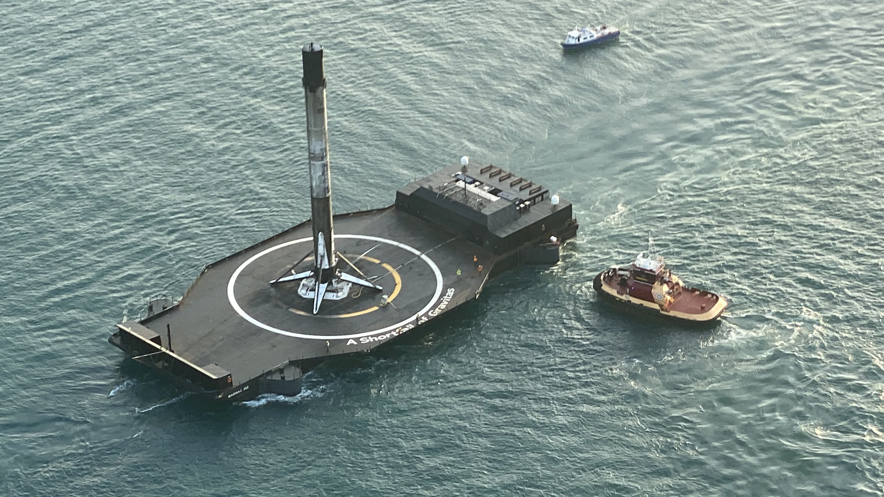
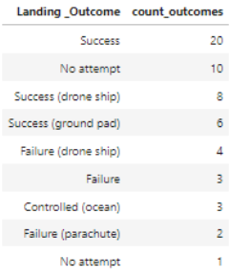
Landing Outcomes
The count of landing outcomes (such as Failure (drone ship) or Success (ground pad)) between the date 2010-06-04 and 2017-03-20, in descending order

Slide 33

Section 3

Slide 34
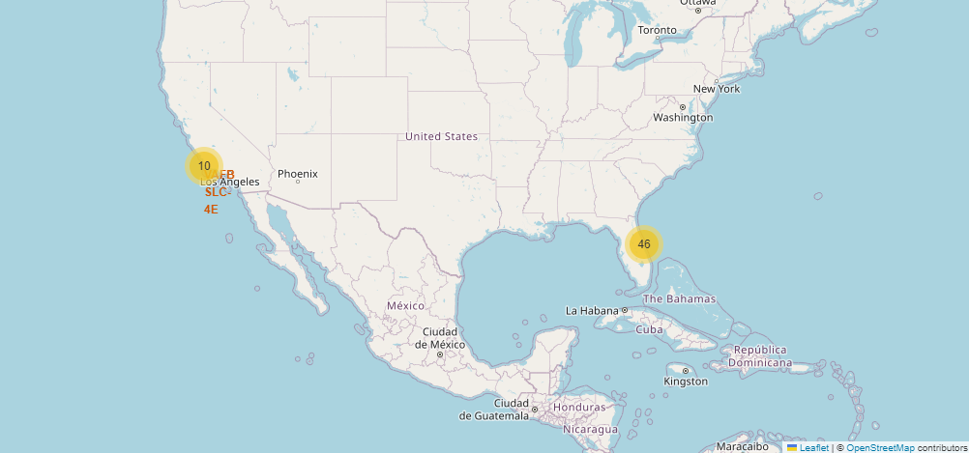
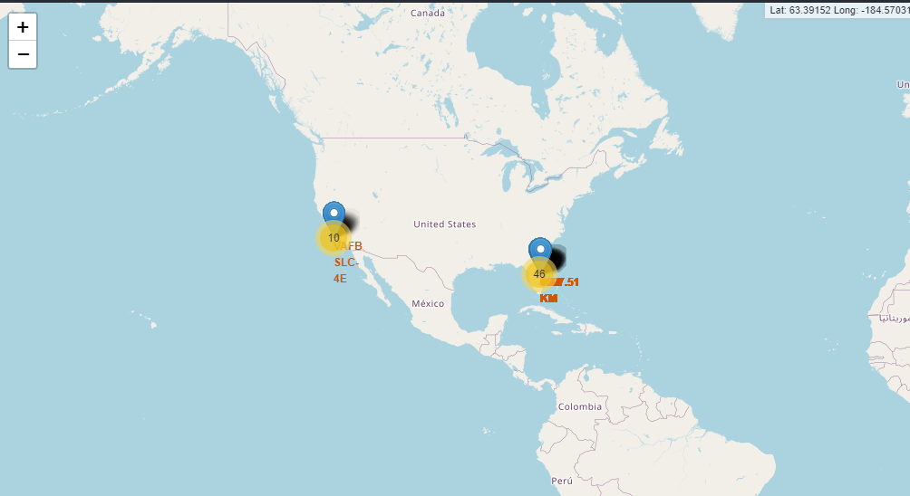
Launch Sites Location
It appears that the launch sites are close to the equator.
The closer the launch site to the equator, the easier it is to launch to equatorial orbit, and the more help you get from Earth's rotation for a prograde orbit. Rockets launched from sites near the equator get an additional natural boost - due to the rotational speed of earth - that helps save the cost of putting in extra fuel and boosters.

Slide 35
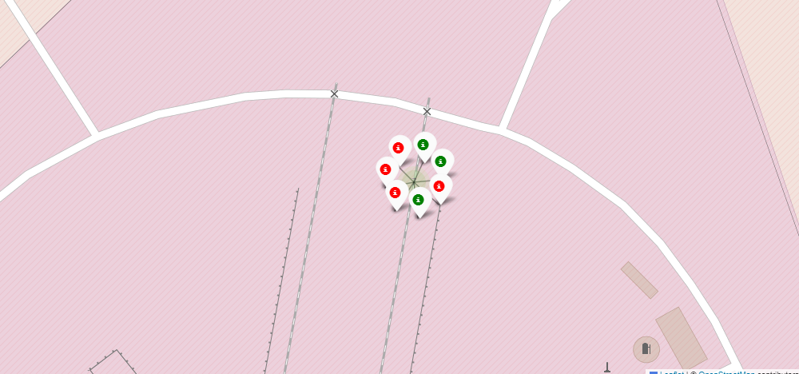
CCAFS SLC-40
Launch site CCAFS SLC-40 has a 3/7 success rate (42.9%). The Green ones are successful launches while the red ones are the failed ones.

Slide 36
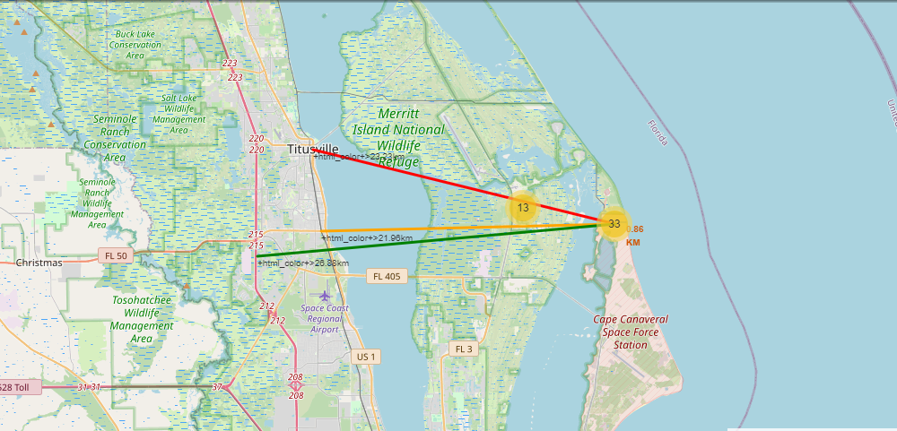
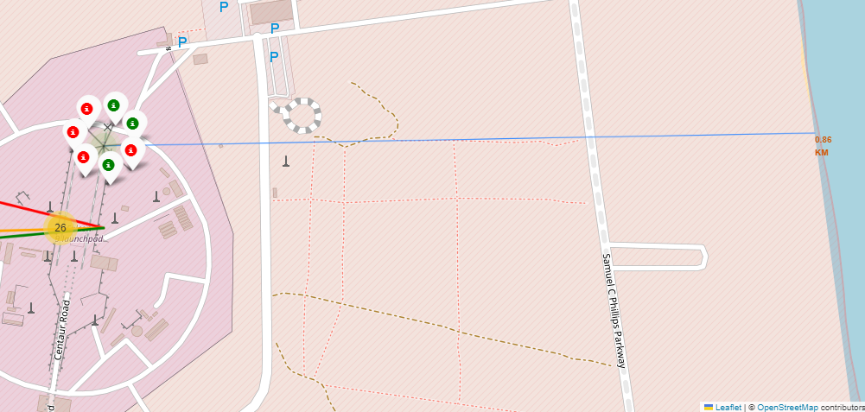
Proximities of Launch Sites
For the launch site CCAFS SLC-40, it is 0.86 km from nearest coastline, 21.96 km from nearest railway, 23.23 km from nearest city, and 26.88 km from nearest highway.
Why?
Coasts: help ensure that spent stages dropped along the launch path or failed launches don't fall on people or property.
Safety / Security: needs to be an exclusion zone around the launch site to keep unauthorized people away and keep people safe.
Transportation/Infrastructure and Cities: need to be away from anything a failed launch can damage, but still close enough to roads/rails/docks to be able to bring people and material to or from it in support of launch activities

Slide 37

Section 4

Slide 38
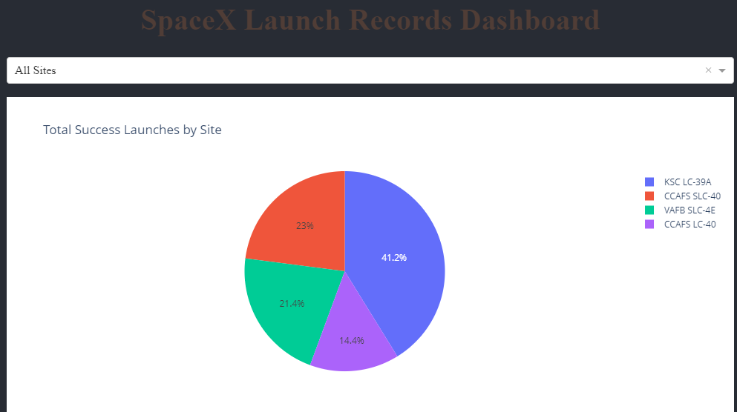
Total Success Launches by Site
Through the pie chart that we show using Plotly Dash, we see that KSC LC-39A is the site that has higher percentage of the total success of all sites, accounting to 41.2% of the total.

Slide 39
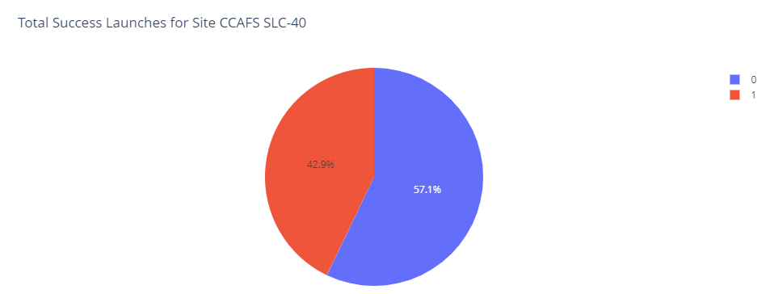
Total Success Launches for Site CCAFS SLC-40
Meanwhile, the site that has the highest success rate is CCAFS SLC-40, which made 42% success out of their launches.

Slide 40
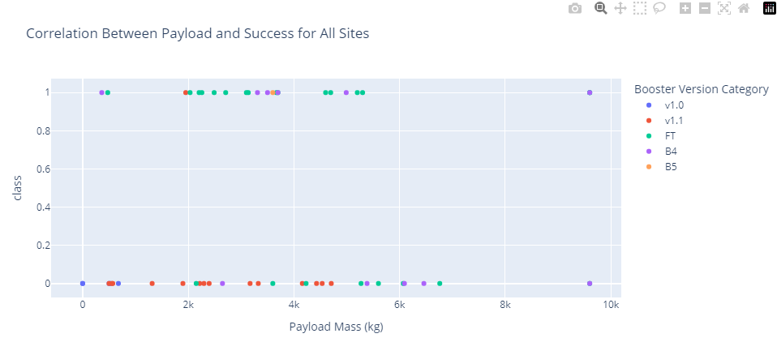
Correlation between Payload and Success for All Sites
Class 1 indicating successful outcome and 0 indicating an unsuccessful outcome
Payloads between 2,000 kg and 5,000 kg have the highest success rate. To be more specific, it is between 2880 and 3840.

Slide 41

Section 5

Slide 42
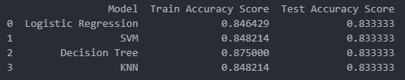
Classification Accuracy
The result shows that all models despite showing different performance on the training data, with Decision Tree producing the highest accuracy, all models’ accuracy on the test set are almost identical here, with the score of 0.833.

Slide 43


Confusion Matrix
Logistic Regression
SVM
Decision Tree
KNN
The confusion matrix applied on the test data shows similar result. The performance of all models are identical.

Slide 44
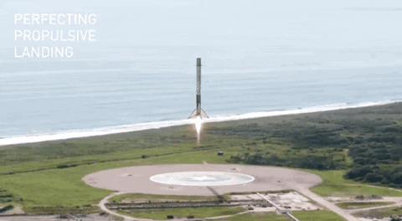
Conclusions
Any of these models can be used for prediction, but simpler models like Logistic Regression or SVM might be preferred due to their interpretability and robustness.
Decision Tree has the highest training accuracy but does not generalize better than the others.
If needed, further hyperparameter tuning or trying ensemble methods (like Random Forest) might improve performance

Slide 45


